Slide 1

G2M insight for Cab Investment firm
Virtual Internship
21 January 2025

Slide 2

Agenda
  Problem Statement
  Dataset Info
  EDA
  Hypothesis tests
  Recommendations

Slide 3
Problem Statement
  XYZ is a private company in the US. Due to strong growth in the cab industry and many competitors, they are considering investing in the industry and want to understand the market first as part of their strategy.
  The objective of the project is to thoroughly analyse and understand the datasets, including their structure, relationships, transformations, and quality, to create a master dataset for further analysis.

Slide 4
Datasets
  The dataset has 4 files, the time period of data is from 30/01/2016 to 31/12/2018.
  Cab_Data.csv: This file includes details of transaction for 2 cab companies.
  Customer_ID.csv: This is a mapping table that contains a unique identifier which the customer’s demographic details
  Transaction_ID.csv: This is a mapping table that contains transaction to customer mapping and payment mode.
  City.csv: This file contains list of US cities, their population and number of cab users.

Slide 5
Exploratory Data Analysis (EDA)

Slide 6
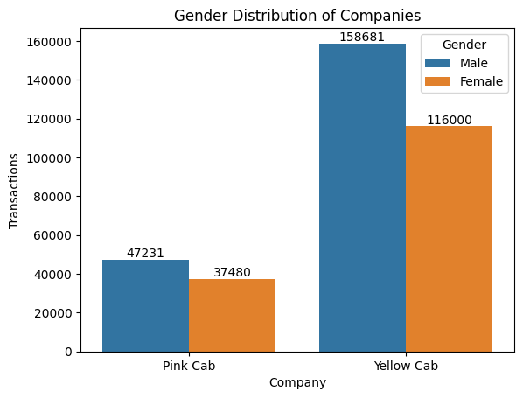
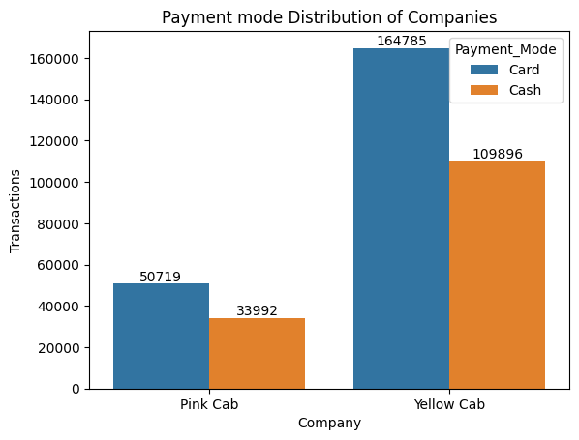

Total transactions made and payment modes of cab companies, categorized by gender.

Slide 7
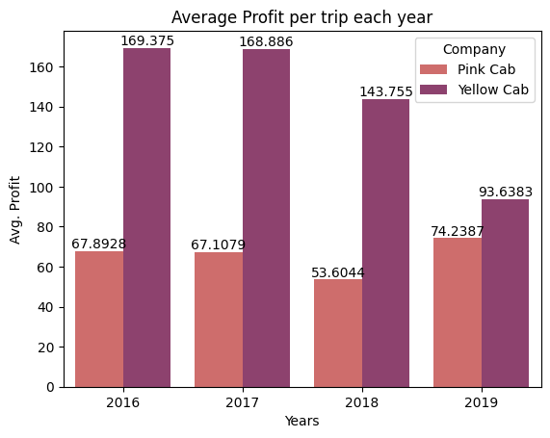
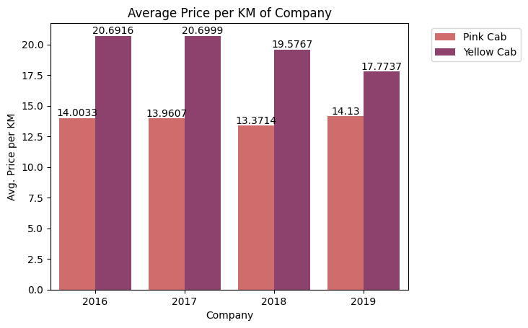
Average profit per trip and average price charged per km by companies each year.

Slide 8
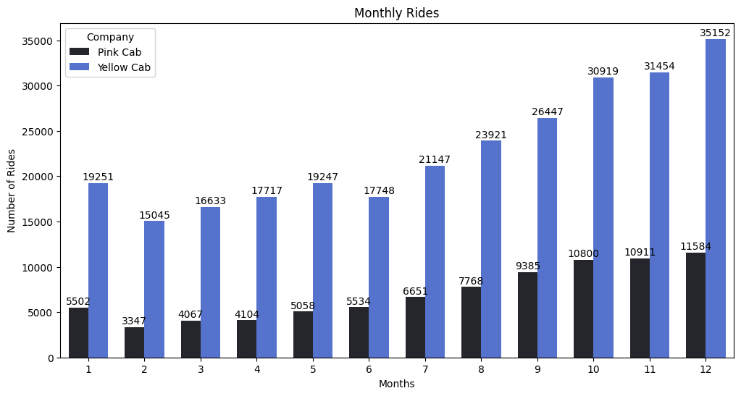
Monthly rides of each Company.

Slide 9
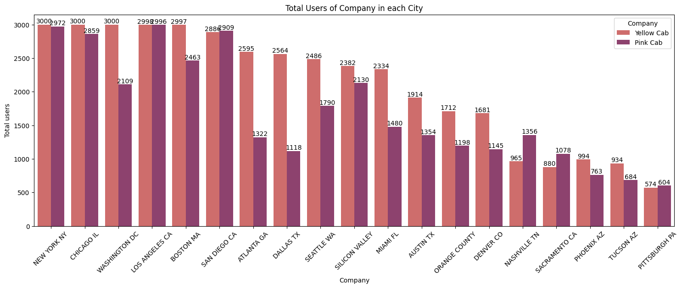
The number of users for each company in each city.

Slide 10
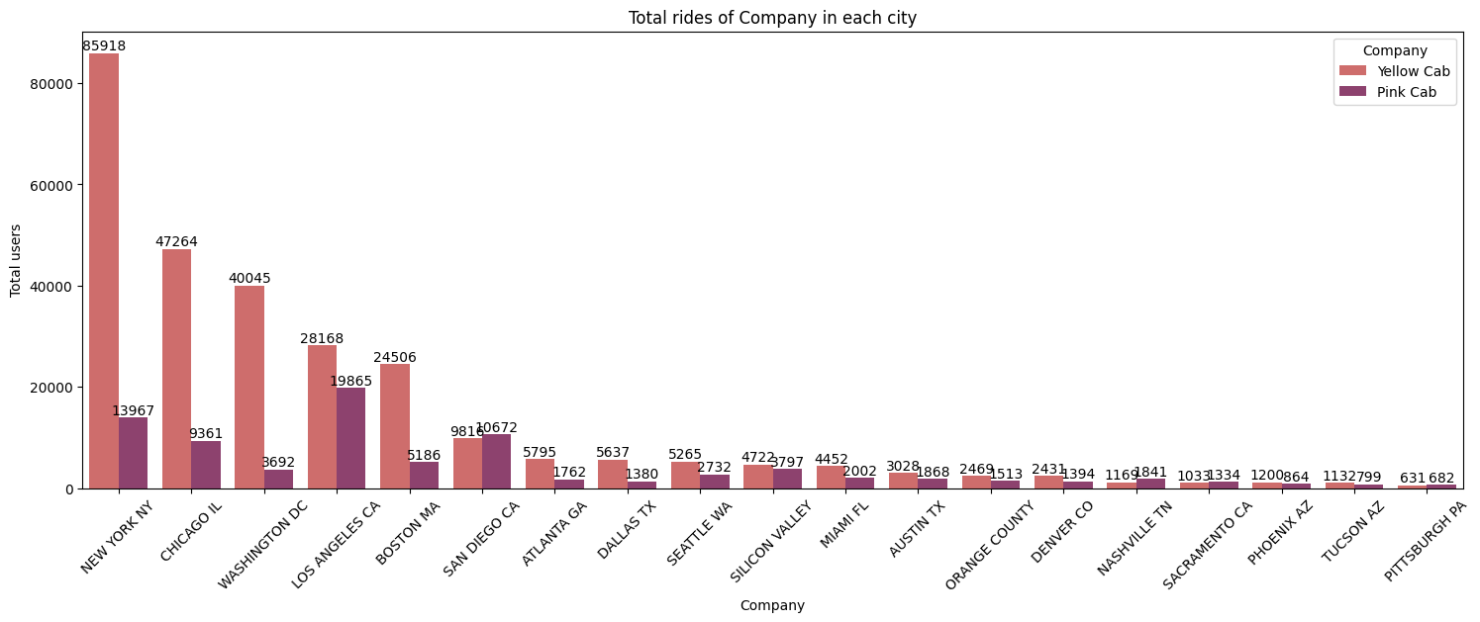
The number of rides for each company in each city.

Slide 11
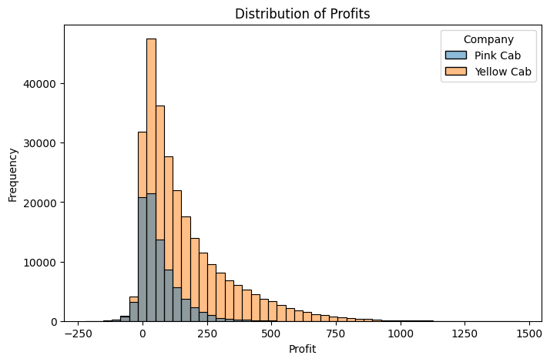
The distribution of profits of each Company.

Slide 12
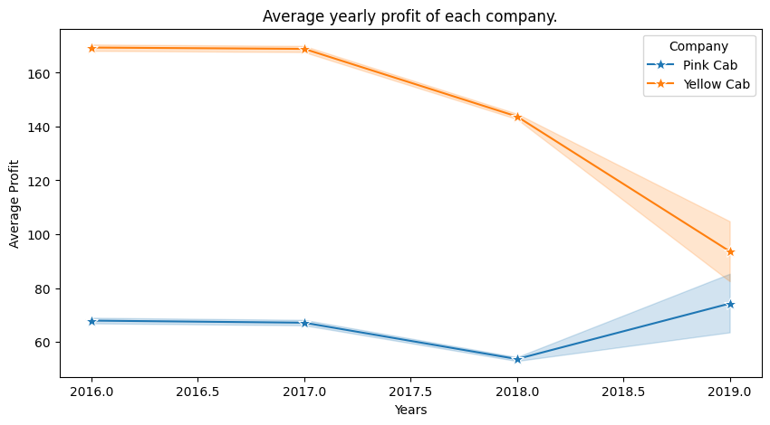
The average profits per year of each Company.

Slide 13
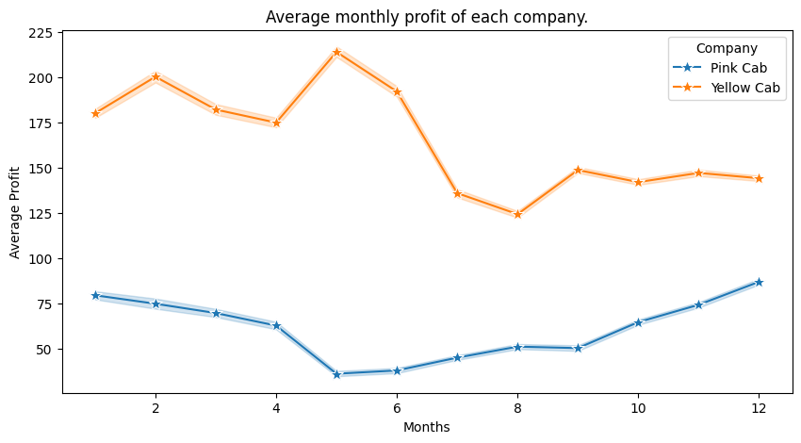
The average profits per months of each Company.

Slide 14
Hypothesis Tests

Slide 15
Gender Hypothesis test
Q: Does gender affect the choice of a cab company?
Null Hypothesis (Ho): Gender does not affect the choice of a cab company.
Alternate Hypothesis (Ha): Gender affects the choice of a cab company.
Significance level: 5%
Test result:
p_value: 3.98e^-25
Interpretation: Reject the Null Hypothesis
Conclusion: As a result, we reject the null hypothesis. meaning gender significantly affects the choice of a cab company.

Slide 16
Income Hypothesis test
Q: Does income plays a role in choosing of a cab company?
Null Hypothesis (Ho): Income does not affect the choice of a cab company.
Alternate Hypothesis (Ha): Income affects the choice of a cab company.
Significance level: 5%
Test result:
p_value: 0.66
Interpretation: Failed to reject the Null Hypothesis
Conclusion: The result shows that a customer’s income does not affect their choice of a cab company.

Slide 17
Companies profits Hypothesis test
Q: Is there a significant difference in the overall profit of companies?
Null Hypothesis (Ho): There is no difference in the companies average profits.
Alternate Hypothesis (Ha): There is a difference in the companies average profits.
Significance level: 5%
Test result:
p_value: 0.0
Interpretation: Reject the Null Hypothesis
Conclusion: The result shows there is a significant difference in the profits per trip of both companies. One of them is making more profit.

Slide 18
Payment mode Hypothesis test
Q: Does the paymenrt mode have any effect on the average profit of a company?
Null Hypothesis (Ho): There is no difference in the companies average profits.
Alternate Hypothesis (Ha): There is a difference in the companies average profits.
Significance level: 5%
Test result:
p_value: 0.0
Interpretation: Reject the Null Hypothesis
Conclusion: The result shows there is a significant difference in the profits per trip of both companies. One of them is making more profit.

Slide 19
Cost per trip Hypothesis test
Q: Is the cost per trip of both companies significantly different?
Null Hypothesis (Ho): There is no difference in the cost per trip of both companies.
Alternate Hypothesis (Ha): There is a difference in the cost per trip of both companies.
Significance level: 5%
Test result:
p_value: 0.0
Interpretation: Reject the Null Hypothesis
Conclusion: As a result, there is a significant difference in the cost per trip of both companies.

Slide 20
Recommendations

Slide 22
Thank You

